Slide 1
Project - P34
Sales target prediction with up-to 10% hike for February 2020

Slide 2
Project Team Members
Namita Bele
Rajeshwari Akhitary
Rahul Goswami
Satish Iyer
Vrushali Naik

Slide 3
Programming & Visualization tools
R for programming & visualization
Tableau for visualization

Slide 4
Presenters
For R : Rahul Goswami
For Tableau : Rajeshwari Akhitary

Slide 5
Uploading data set in R and check its feature types
Set the environment or install required package for loading file.
First we upload the “Validation_Data” data set excel file in R or Import the “Validation data” data set excel file in R global environment.
Checked the types of data set features and got starting two features(PROD_CD & SLAMAN_CD) are character and remaining four features are numerical.

Slide 6
Two types of EDA process
Normal EDA
Automated EDA

Slide 7
Normal EDA Process at Validation dataset

Slide 8
Feature type conversion, their descriptive analysis & find missing values in data
Converted the all character features into numerical features.
Executed the summary of all variable features and get the descriptive analysis (min. , max., median,1st and 3rd quartile of features values) of them.
As per PROD_CD feature summary we have total 58 types of products for selling in the market.
As per SLSMAN_CD feature summary we have total number of 177 salesman for selling products.
As per target feature summary we have minimum target Rs.6 & maximum Rs.299208 in assign targets for January 2020.
Checked the missing values & got the no missing values in data set.

Slide 9
Checked the correlation between all features
SALSMAN_CD and PROD_CD are highly correlated.
PLAN_MONTH has no correlation with all features.
SLSMAN_CD & TARGET_IN_EA have good positive relation but not moderate or high. .
PROD_CD & TARGET_CD have good positive relation but no moderate or high.
SLSMAN_CD & PROD_CD have positive relationship but not moderate or high.
TARGET_IN_EA & ACH_IN_EA have no correlation.
PLAN_YEAR has no correlation with all feature.

Slide 10
Set the environment for visualization
Installed and attached the “lattice” package in R environment.

Slide 11
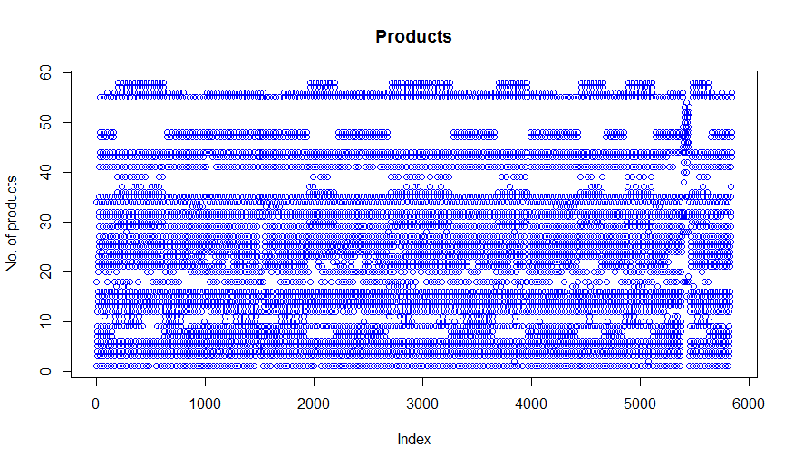
Visualization of individual variable features:
PROD_CD Feature:
Insights:
Product 22-26 have
distributed across all
observation.
Similarly few other product
range have also presence in
all observation.
Some products (38-39) are
very less distribution
throughout the
observation.
Products 49-54 are very less
presence throughout the
observation.

Slide 12
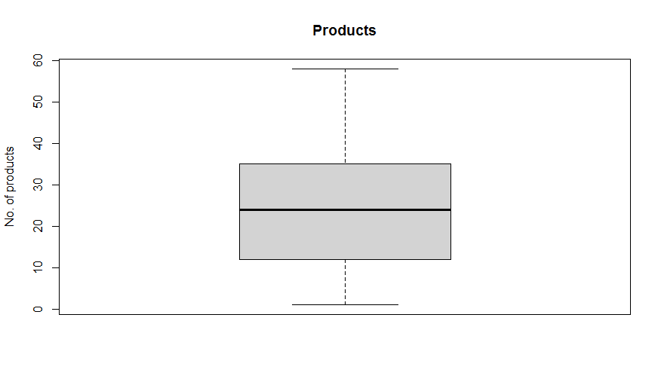
BOX Plot of PROD_CD
Insights :
As per box plot there are no
outliers in this feature.

Slide 13
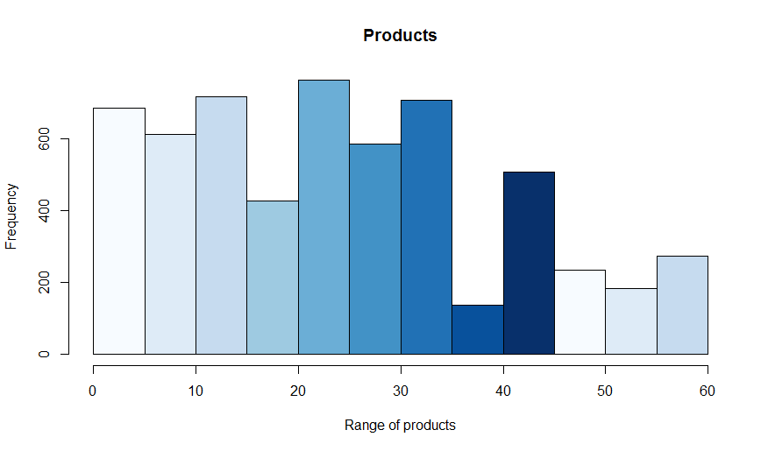
Histogram of PRO_CD
Insights:
As per histogram products
frequency is very high
between 20-35 range of
products.
No skewness in this feature.

Slide 14
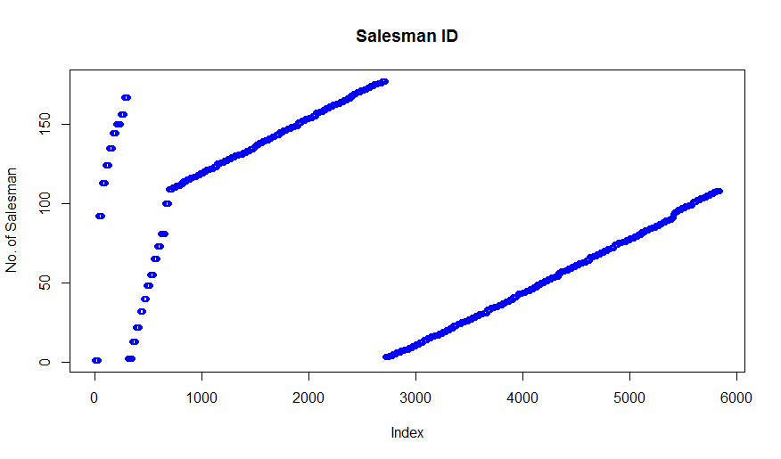
Plot of SLSMAN_CD
Insights:
Between 2700 to 5900
observation salesman 1 to 90
are present.
Between 60 to 2600
observation salesman 110
- 177 are present.

Slide 15
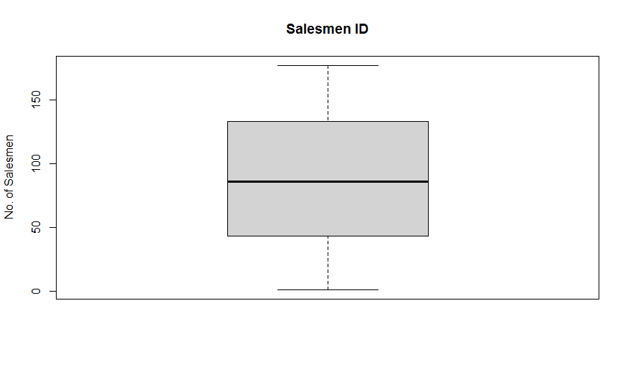
BOX PLOT of SLSMAN_CD
Insights:
There is no outliers in
this feature.

Slide 16
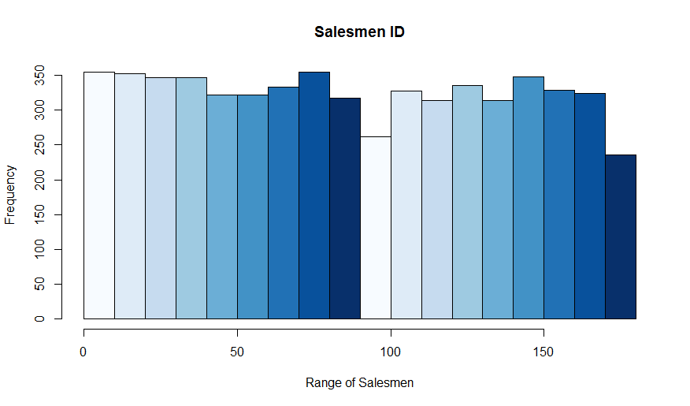
Histogram of SLSMAN_CD
Insights:
Salesman 40-90 has very
high frequency distribution.
No. skewness in dataset.

Slide 17
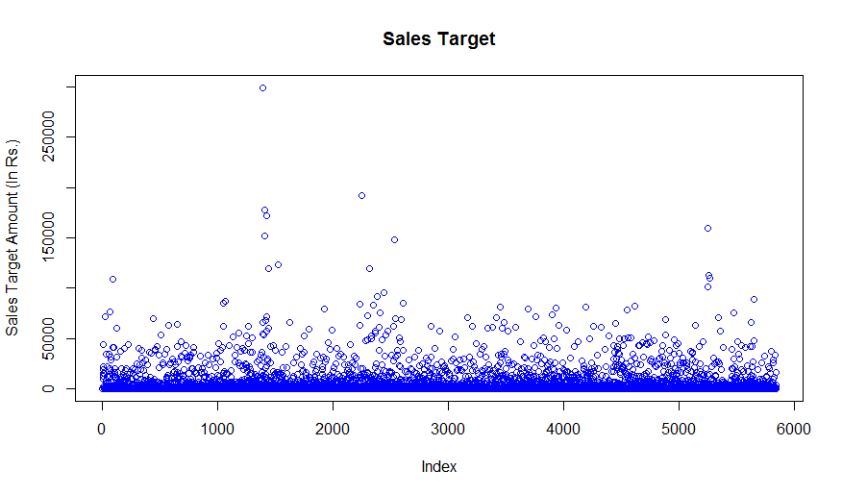
Plot of TARGET_IN_EA
Insights:
Targets between 1-
4800Rs.are assigned more
to most of salesman's.
Between 140 to 250
observations targets are
high.

Slide 18
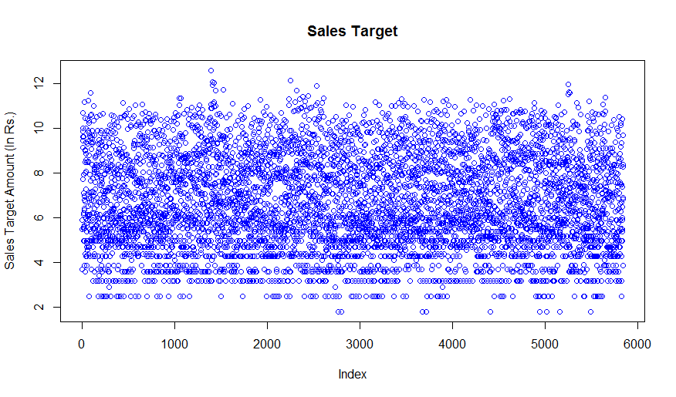
Plot of Transformed TARGET_IN_EA
Insights:
After log transformation
of targets we can say that
targets are almost equally
distributed across all
observations.

Slide 19
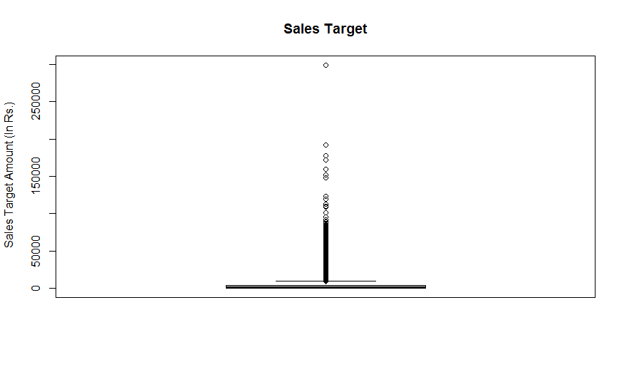
Box Plot of TARGET_IN_EA
Insights:
As per box plot there are
so many outliers in this
feature.

Slide 20
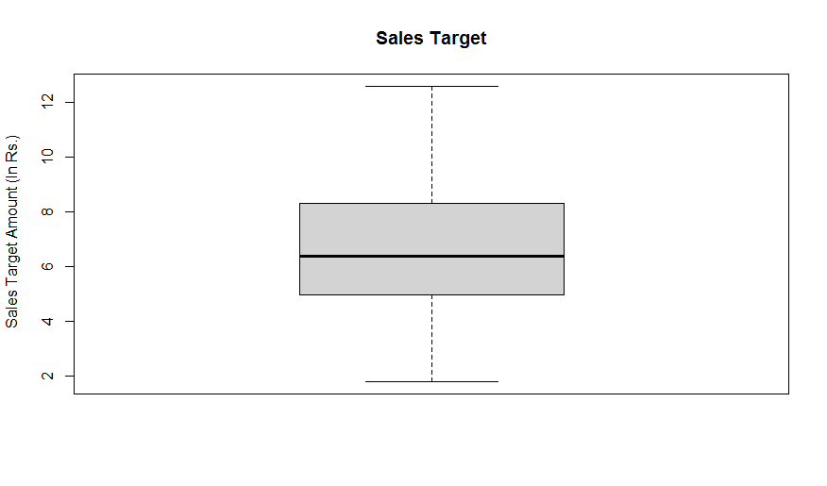
Box Plot of transformed TARGET_IN_EA
Insights:
After log transformation
of targets we can say
that targets have no
outliers.

Slide 21
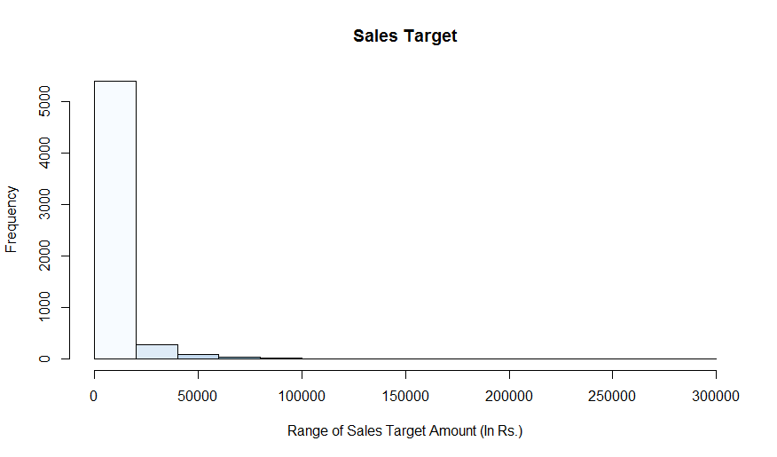
Histogram of TARGET_IN_EA
Insights:
1-3000Rs. target range have very
high frequency.
This feature has positive
skewness.

Slide 22
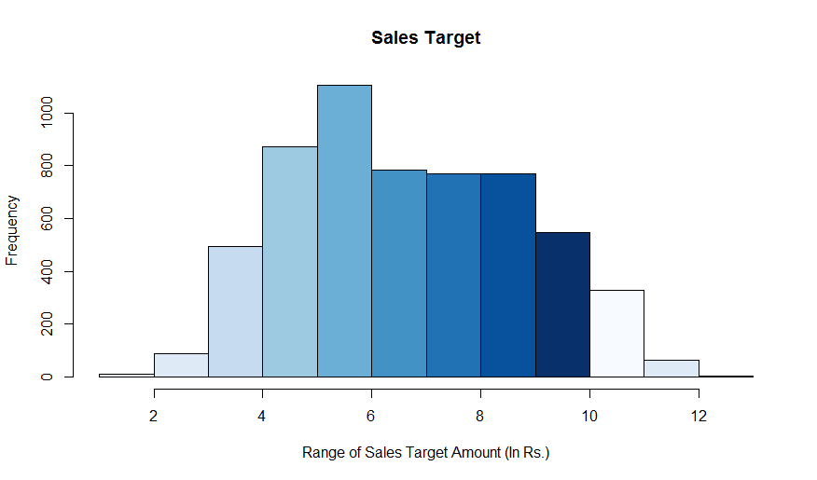
Histogram of transformed TARGET_IN_EA
Insights:
After transformation of
targets we can say that
targets have positive &
negative skewness.

Slide 23
ggplot2 visualization
Set the environment or install packages for ggplot2 visualizations.
Attach the package in environment.

Slide 24
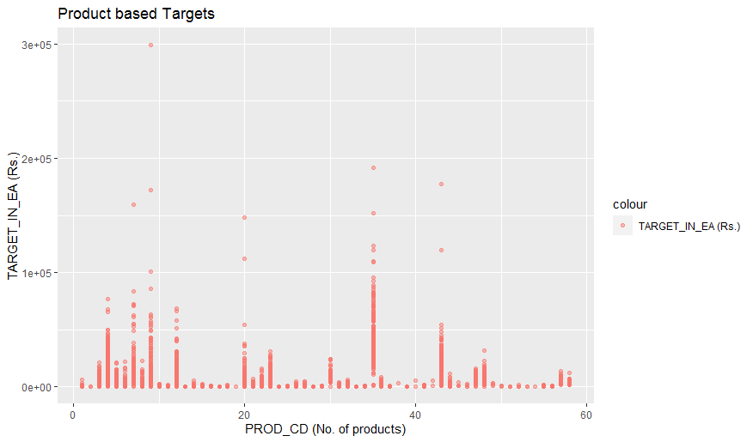
Visualization of two individual variable features
PROD_CD & TARGET_IN_EA distribution comparison analysis:
ggplot2 plot:
Insights
Product range 4- 10 has
high target value.
Product range 51-58 has
lowest target value.

Slide 25
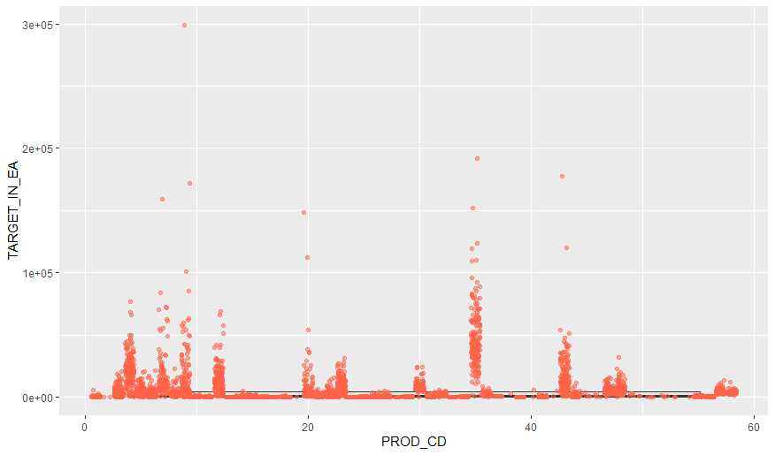
Box Plot
Insights:
Product range 4-10 has outliers
across target.
Similarly few other product
range have also outliers across
target values.

Slide 26
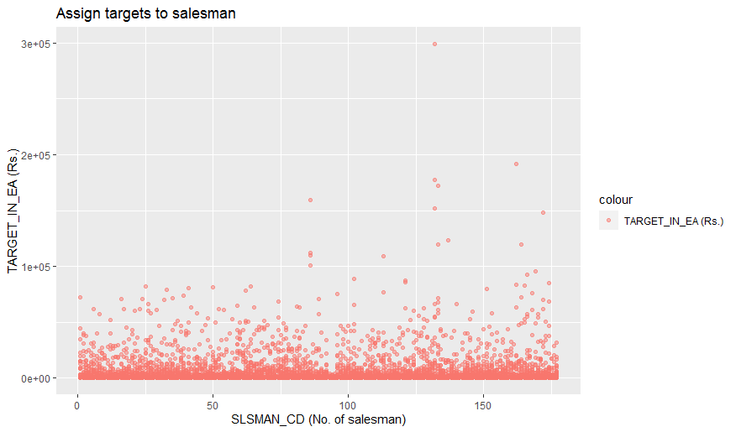
SLSMAN_CD & TARGET_IN_EA distribution comparison analysis
ggplot2 plot:
Insights:
Salesman 125-177 have
high sales target.
Salesman 1-90 have
90000Rs. sales
target.

Slide 27
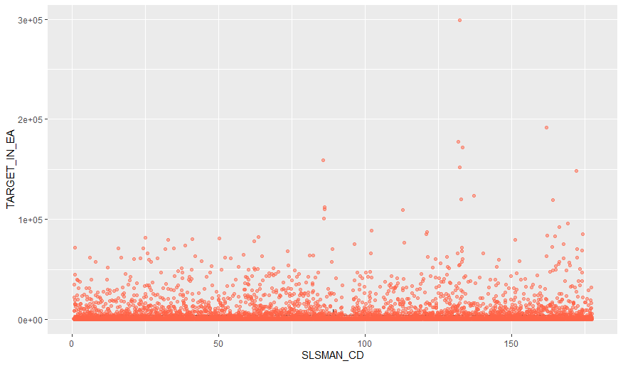
Boxplot
Boxplot2 :
All salesman range has outliers
across target values.

Slide 28
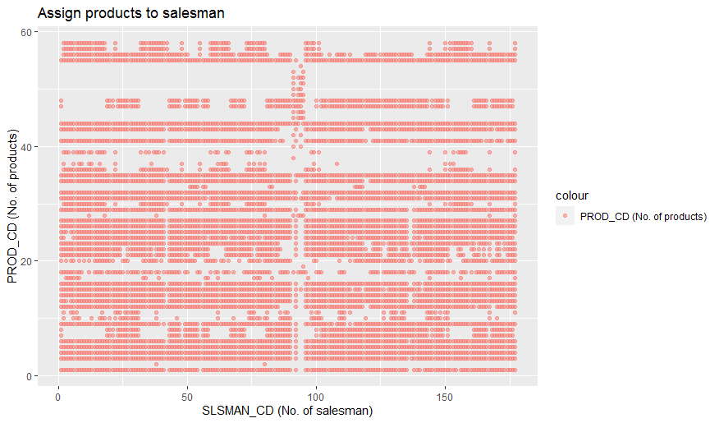
SLSMAN_CD & PROD_CD distribution comparision analysis
ggplot2 plot:
Almost all products are
assigned to all salesman's.
Product 49-55 are
assigned to only 94-96
salesman.

Slide 29
Automated EDA Process Uploading data set in R
Set the environment or install required package for loading file.
First we upload the “Validation_Data” data set excel file in R or Import the validation data set data set excel file in R global environment.

Slide 30
Set the environment for automated EDA & converted character feature into numerical
Set the environment or installed package "DataExplorer“ & attached it in environment.
Checked the types of data set features and got starting two features(PROD_CD & SLAMAN_CD) are character and remaining four features are numerical.
Converted character features(PROD_CD & SLAMAN_CD) into numerical.

Slide 31
Summary of all variable features
Summary of PROD_CD states that it have 58 types of products.
Summary of SLSMAN_CD states that it have total 177 salesman.
Summary of TARGET_IN_EA states that it have targets range from 6 to Rs.2,99,208 of salesman’s.

Slide 32
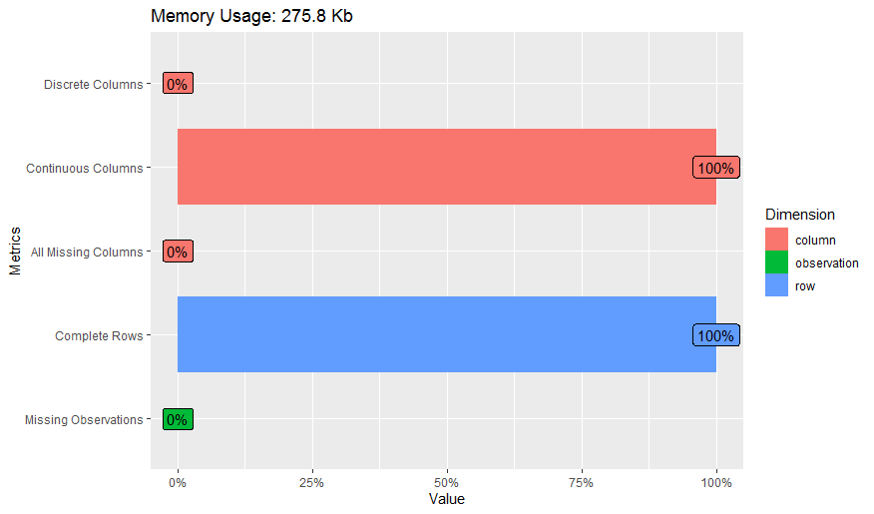
Checking the features types & overall missing values in data by plot
Insights:
All features are continues.
There are no missing
values in data set.
Validation data has no
no missing values.

Slide 33
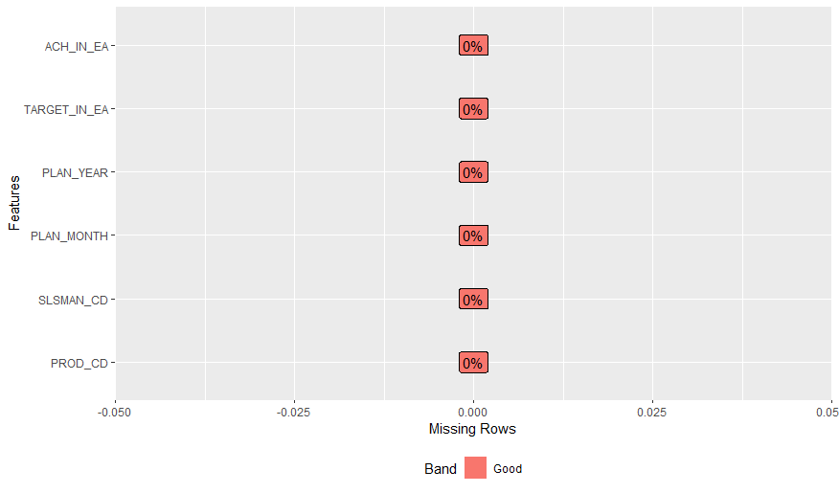
Find the missing values in individual feature by plot
Insights:
All features have no
missing values.

Slide 34
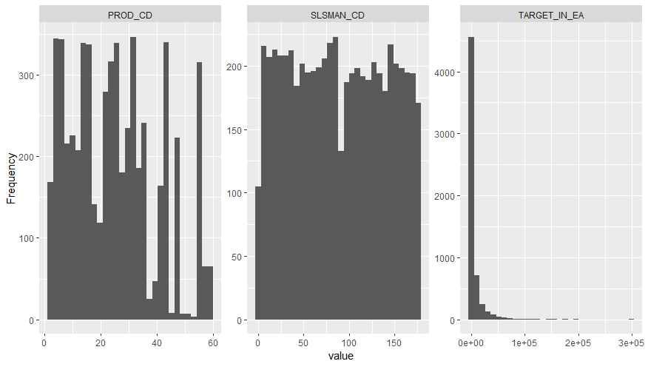
Histogram of all variable features
Insights:
PROD_CD have
positive skewness.
22-38products have high
frequency & product 55-
58 have lowest frequency.
SLSMAN_CD have no
skewness.
Salesman 1-90 has
highest frequency
distribution.
TARGET_IN_EA have
positive skewness.
Target value 1-40000Rs.
have highest frequency.

Slide 35
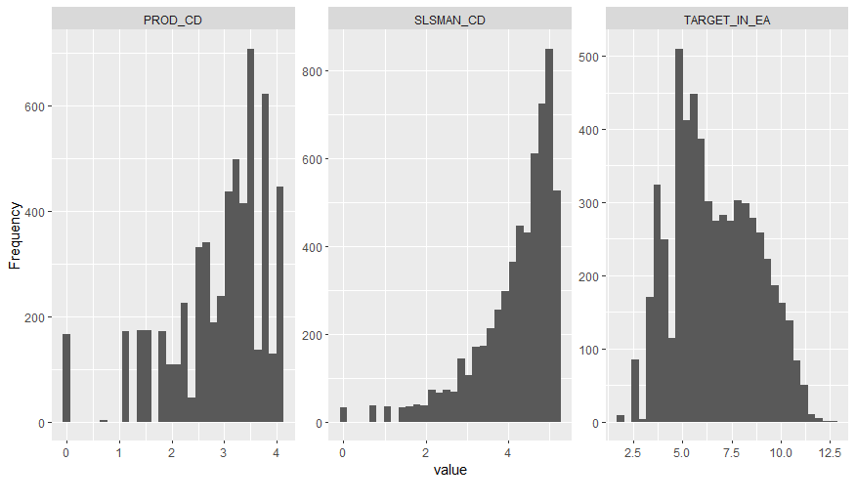
Histogram of all transformed variable features
Insights:
Products have negative
skewness.
Salesman’s have
negative skewness.
Targets have positive &
negative skewness.

Slide 36
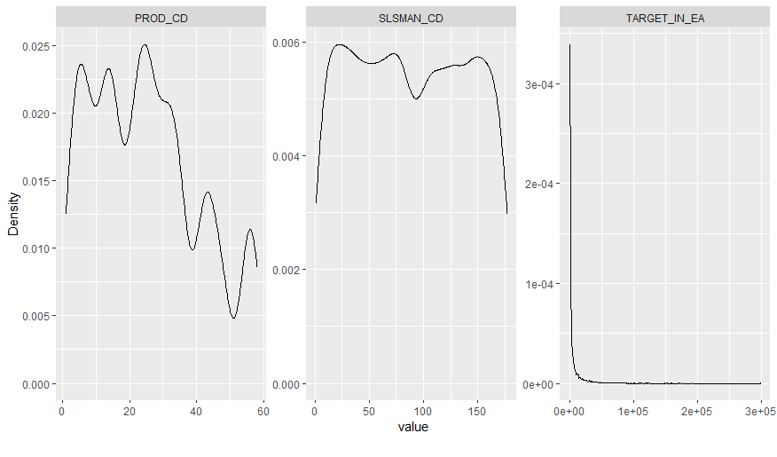
Density plot of all variable features
Insights:
Products range 10-25
have higher density.
10-20 salesman have
higher density.
1-25,000Rs. target
range have high
density.
In products range 26-40
products density
reduces drastically
across all observations.
In salesman’s range
150-177 salesman’s
density have
drastically reduced
across all observations.

Slide 37
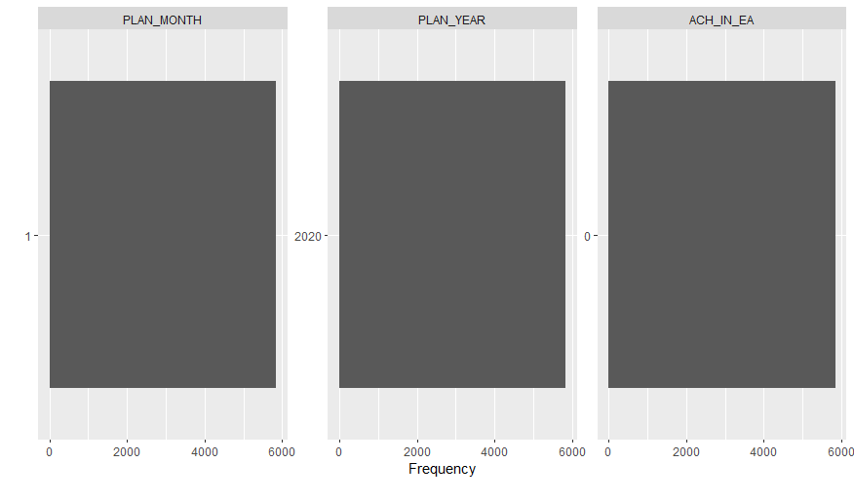
Bar Plot for validation data
Insights:
As per bar plot all
three features have no
variation in their data.

Slide 38
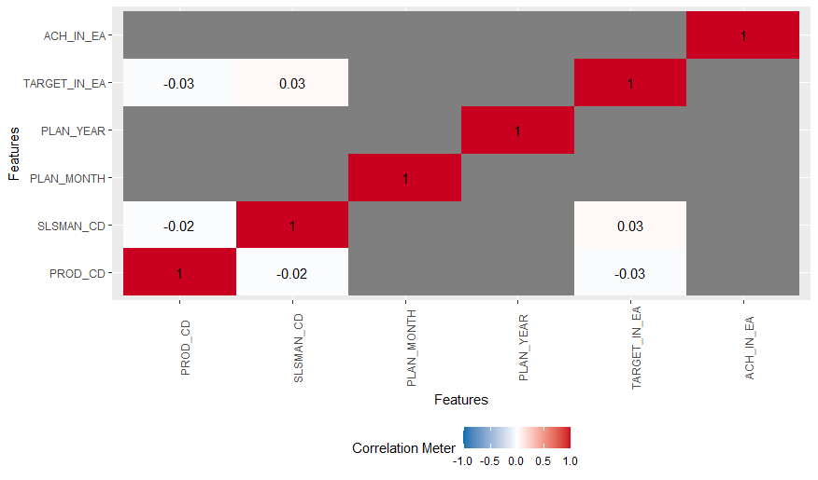
Correlation between all features
Insights:
Product & target has
negative correlation.
Salesman's & Targets
have less positive
correlation.
Products &
salesman's have
negative correlation.
Plan Month , Year &
Achievement have
no correlation.

Slide 39
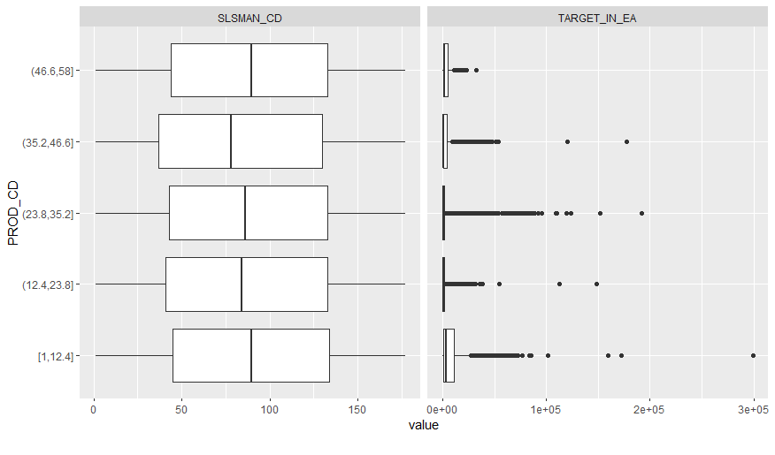
Box Plot by all variable features across PRODUCT_CD
Insights:
Products are assigned
to almost all salesman
for selling them.
Products 1-13 range
have highest target
value.
Products 46 to 58
lowest target values.
All targets have
outliers across
all products range.

Slide 40
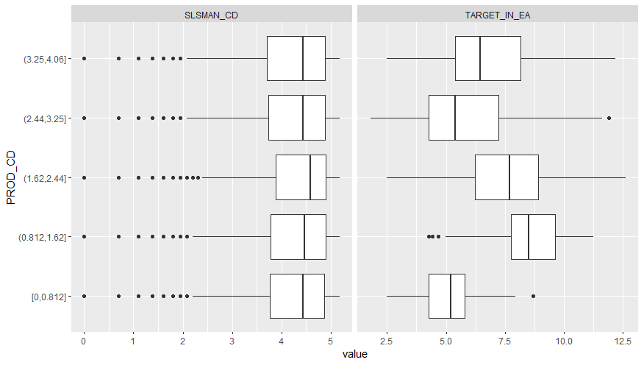
Box Plot by all variable features across transformed PRODUCT_CD
Insights:
SALSMAN_CD has
lower extreme outliers
across PROD_CD.
TARGET_IN_EA has
outliers across
PROD_CD.

Slide 41
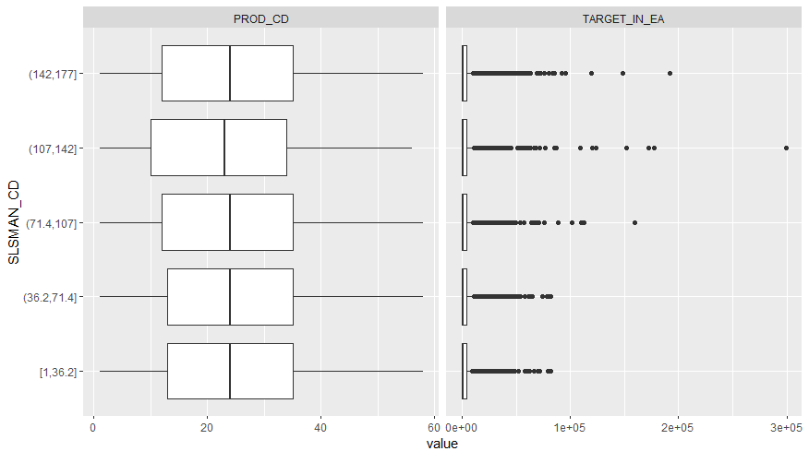
Box Plot by all variable features across SLSMAN_CD
Insights:
Almost all salesman’s
have all products
assigned for selling.
Salesman 1-36 have
have very less targets.
Salesman 107-142
have higher targets.
All other salesman’s
have moderate
targets.
All Targets have
higher extreme
outliers across
salesman’s.

Slide 42
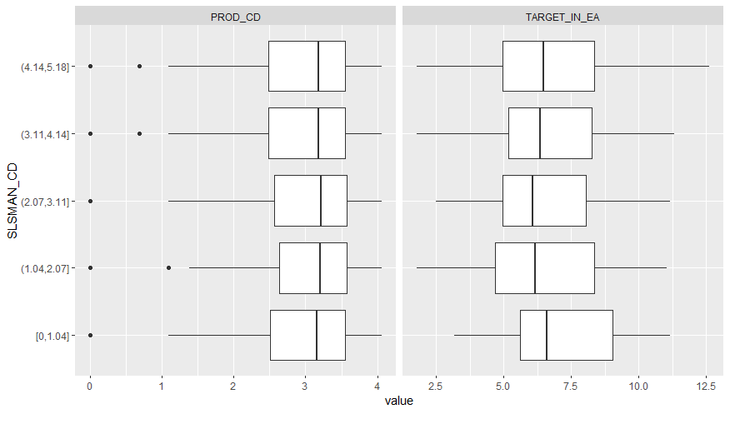
Box Plot by all variable features across transformed SLSMAN_CD
Insights:
Products have
outliers across
salesman's.
TARGET_EA have no
outliers across
targets.

Slide 43
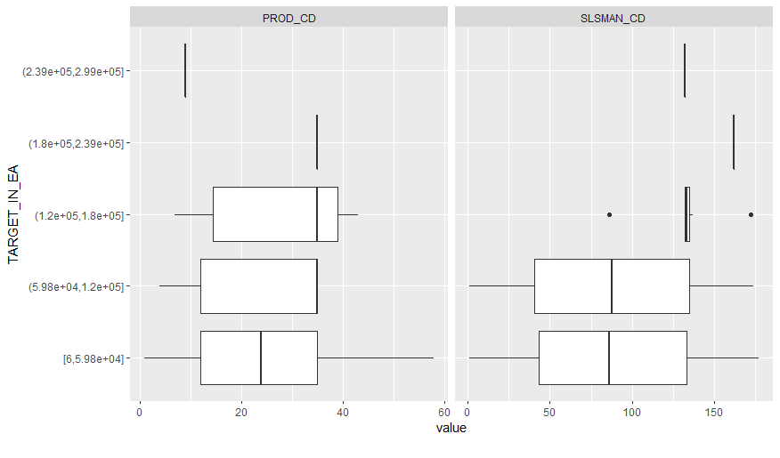
Box Plot by all variable features across TARGET_IN_EA
Insights:
Products has no
outliers across
targets.
Salesman's( 87 & 177 )
have outliers across
1.20Lac to 1.8Lac Rs.
target range.
All others salesman's
have no outliers
across remaining
target range.

Slide 44
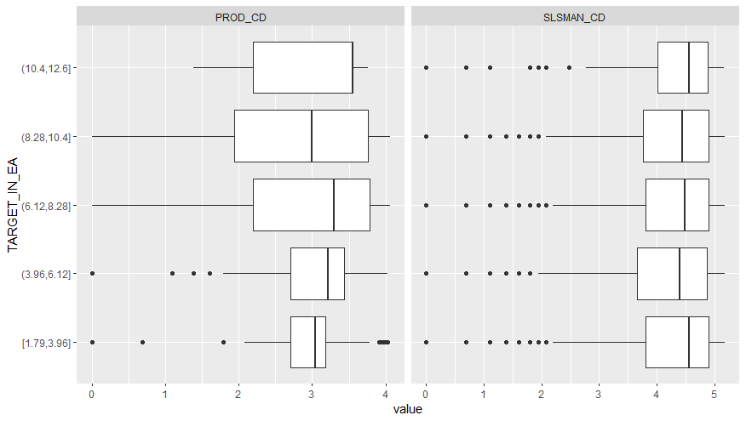
Box Plot by all variable features across transformed TARGET_IN_EA
Insights:
Products &
salesman feature
have lower extreme
outliers across
targets.

Slide 45
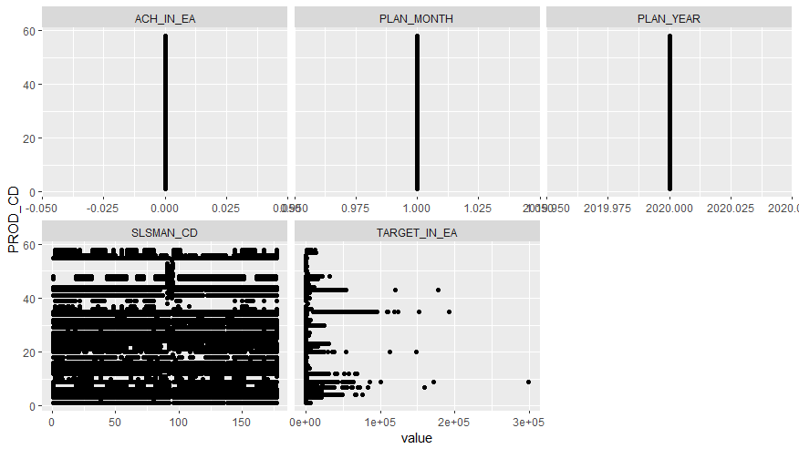
Scatter plot by all features across PROD_CD
Insights:
Products range 1-30 have
assigned to almost all
salesman’s for selling .
Products range 46-55 have
very less assigned to all
salesman’s.
Products range 1-13 have
very high target values.
Products range 48-58 have
very less targets.
There is no achievements
across products.
All products are allocated
to sell for 2020 Year & Jan
month.

Slide 46
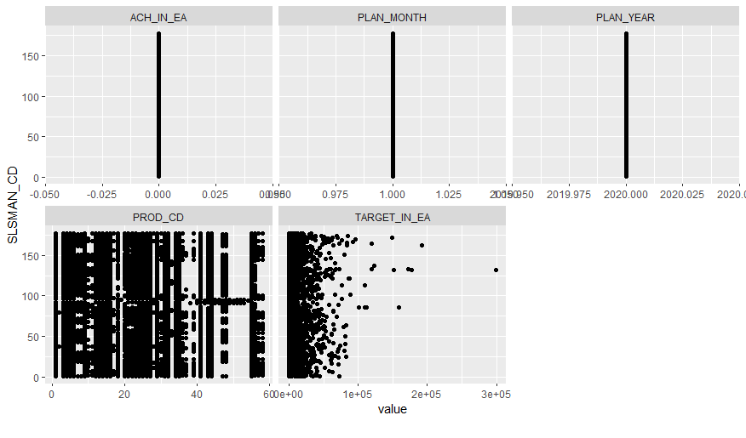
Scatter plot by all features across SLSMAN_CD
Insights:
Almost all salesman’s
have assigned
products range 1-30
for selling .
All salesman are not
assigned product
range 48-55 after
two salesman's 98-99.
All salesman's have
no achievements.

Slide 47
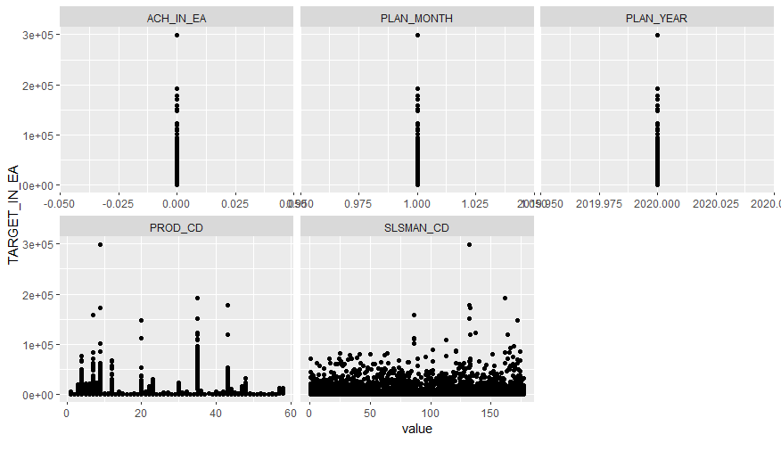
Scatter plot by all features across TARGET_IN_EA
Insights:
All achievements are
zero across all targets.
Targets are assigned
for Jan 2020 &
Year2020.
Products range 48-58
have very less targets.
Products 1-13 have
higher target range.
Salesman 107-142
have higher target
range.

Slide 48
Visualization HTML report generation in webbrowser of all features
Code for creating report:
create_report(Validation_Dataset)

Slide 49
Automated EDA Process for Final data set
Set the environment or install required package for loading file.
First we upload the “Final_Data” data set excel file in R or Import the validation data set data set excel file in R global environment.

Slide 50
Set the environment for automated EDA & converted character feature into numerical
Set the environment or installed package "DataExplorer“ & attached it in environment.
Checked the types of data set features and got starting two features(PROD_CD & SLAMAN_CD) are character and remaining four features are numerical.
Converted character features(PROD_CD & SLAMAN_CD) into numerical.

Slide 51
Summary of all variable features
Summary of PROD_CD states that it have 86 types of products.
Summary of SLSMAN_CD states that it have total 224 salesman.
Summary of PLAN_MONTH states that it have total 3 month.
Summary of TARGET_IN_EA states that it have targets range
from 0 to Rs.3,02,400 of salesman’s.
Summary of ACH_IN_EA states that it have achievements range from 0 to Rs. 2,95,578 of salesman’s.

Slide 52

Checking the features types & overall missing values in data by plot
Insights:
All features are
continuous type.
Data set have no
missing values.

Slide 53
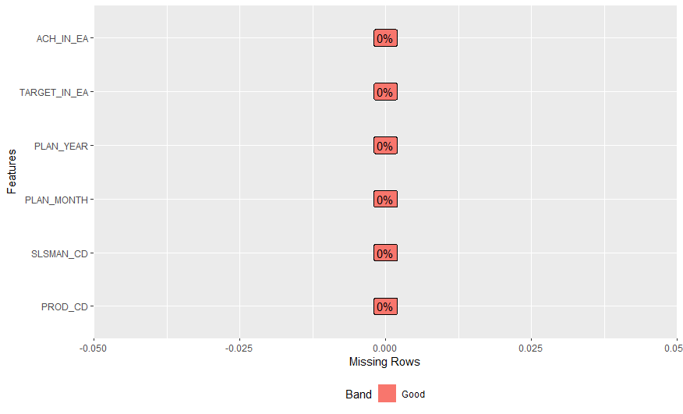
Checking the features types & overall missing values in data by plot
Insights:
All features have no
missing values.

Slide 54
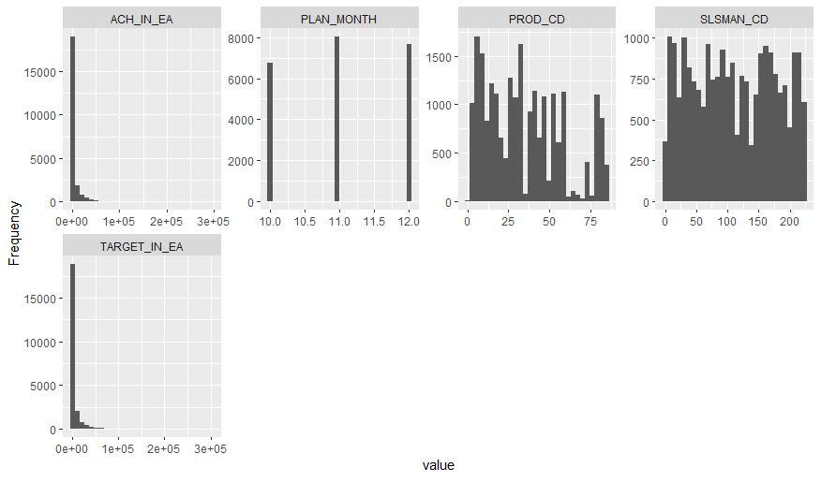
Histogram of all variable features
Insights:
Achievements have
positive skewness.
Plan month have no
skewness.
PROD_CD have no
skewness.
SLSMAN_CD have no
skewness.
TARGET_IN_EA have
positive skewness.

Slide 55
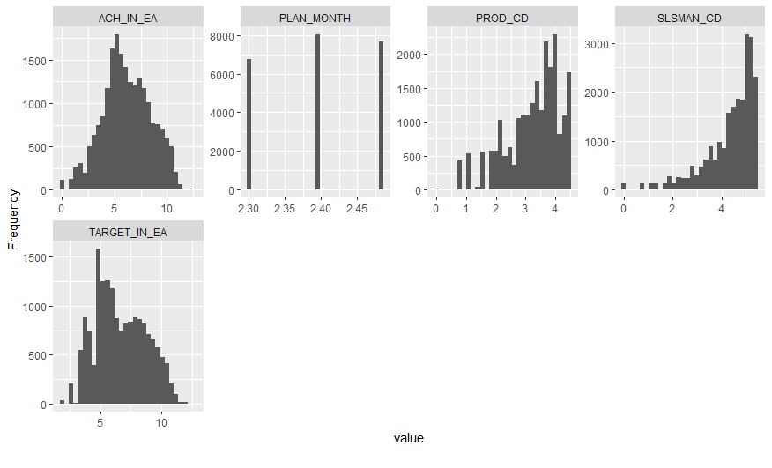
Histogram of all transformed variable features
Insights:
ACH_IN_EA have
positive & negative
skewness.
PLAN_MONTH have
no positive &
negative skewness.
PROD_CD have
negative skewness.
SLSMAN_CD have
negative skewness.
TARGET_IN_EA have
positive & negative
skewness.

Slide 56
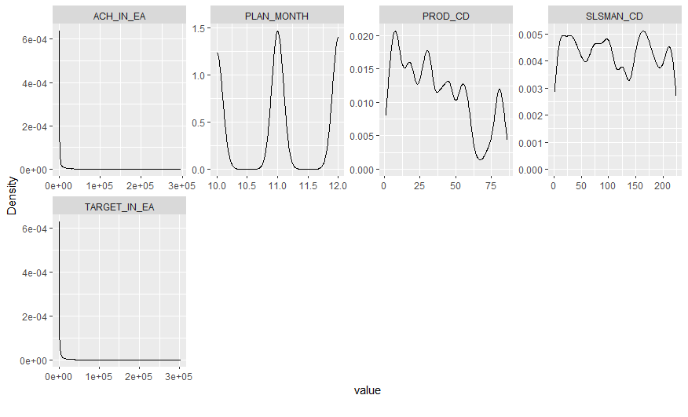
Density plot of all variable features
Insights:
0-Rs.40000 achievements
range have higher density
across all observations.
Products 32-67 range
densities are drastically
. reduced across all
observations
Salesman’s 100-137
& 212-224 ranges density is
drastically very less.
Targets 0-Rs20,000 range
have highest density across
all observations.

Slide 57
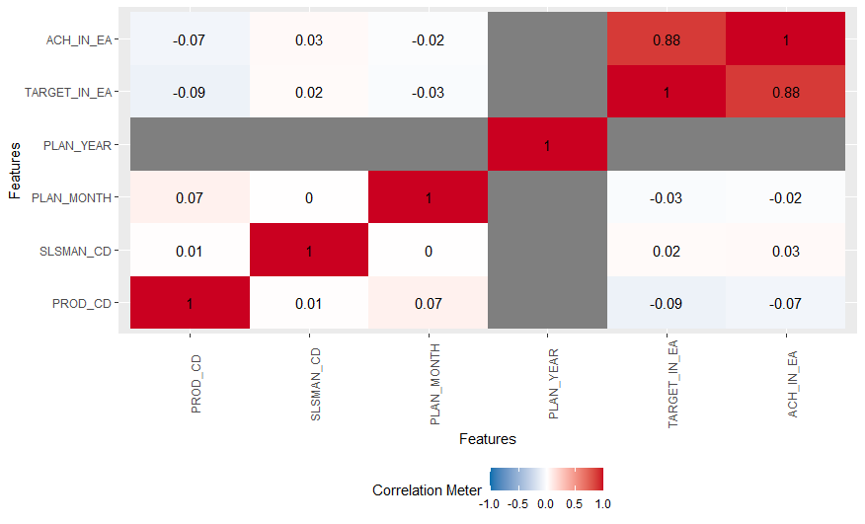
Correlation between all features
Insights:
Product &
achievement have
negative
correlation.
Product & target
have negative
correlation.
Salesman's & Targets
have less positive
correlation.
Salesman’s &
achievements have
more positive
correlation.
Target &
achievement
have 88% positive
correlation.

Slide 58
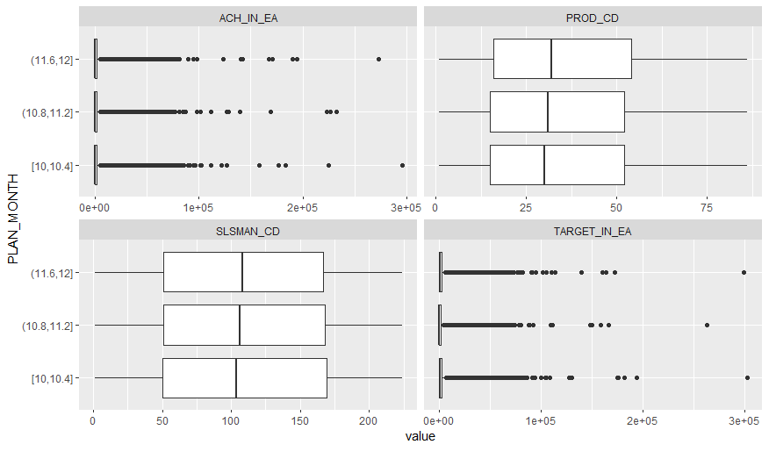
Box Plot by all variable features across PLAN_MONTH
Insights:
Achievements & targets
have outliers across
three months.
Products & Salesman’s
have no outliers across
three months.

Slide 59
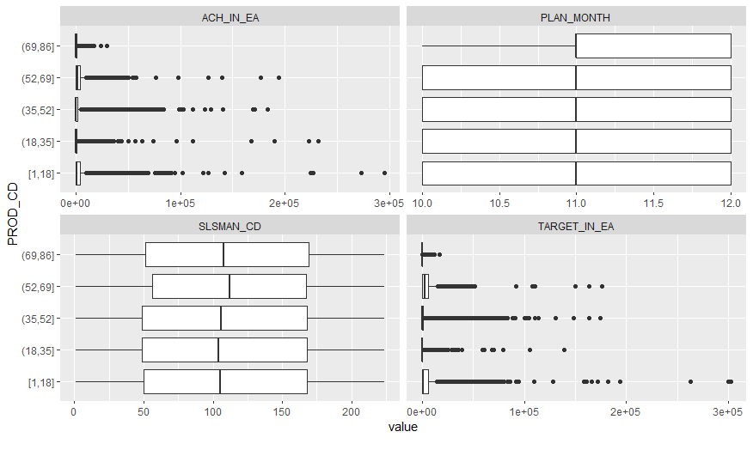
Box Plot by all variable features across PRODUCT_CD
Insights:
Ac & targets
have outliers across
products.
Plan months &
salesman’s have no
outliers across
products.

Slide 60
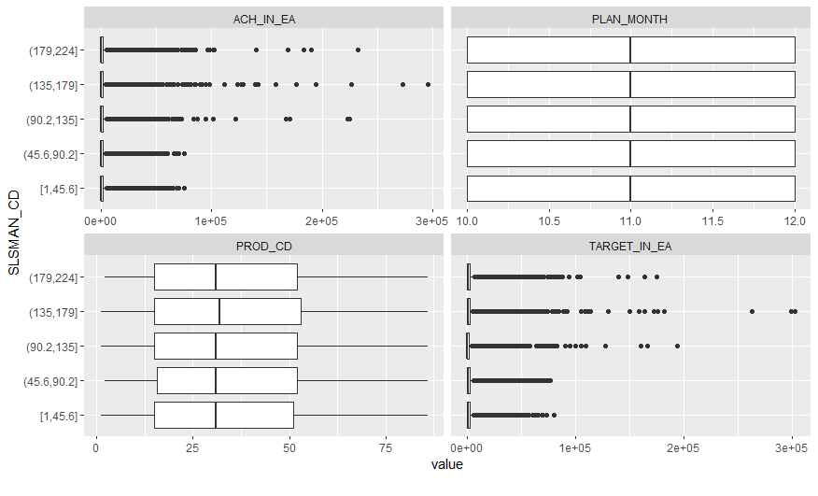
Box Plot by all variable features across SLSMAN_CD
Insights:
Targets &
achievements
have outliers across
salesman’s.
Plan months &
products have no
outliers across
salesman’s.

Slide 61
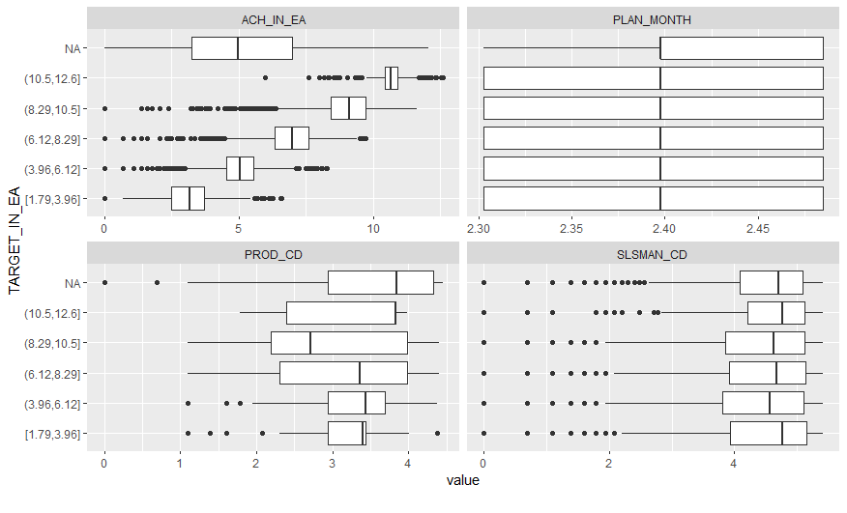
Box Plot by all variable features across TARGET_IN_EA
Insights:
Achievements,
products & salesman’s
have outliers across
targets.
Plan month have no
outliers across targets.

Slide 62
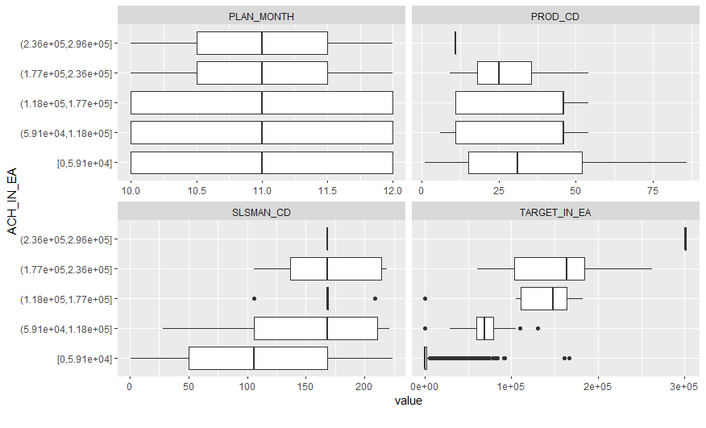
Box Plot by all variable features across ACH_IN_EA
Insights:
Salesman’s & targets
have no outliers
across achievements.
Plan months &
products have no
outliers across
achievements.

Slide 63
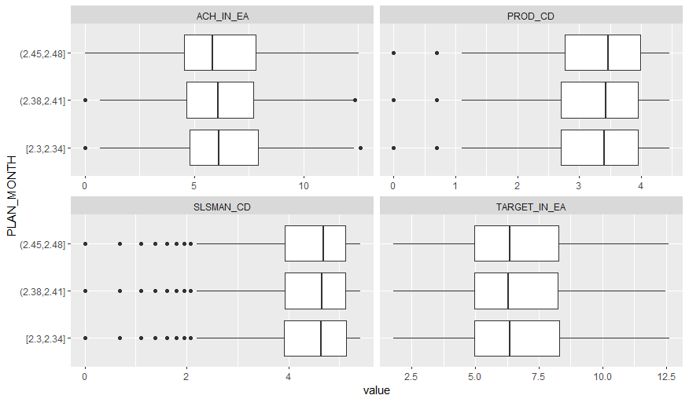
Box Plot by all variable features across transformed PLAN_ MONTH
Insights:
Targets have no
outliers
across plan months.
Achievements have
outliers across plan
months.
Products & Salesman’s
have lower extreme
outliers across plan
months.

Slide 64
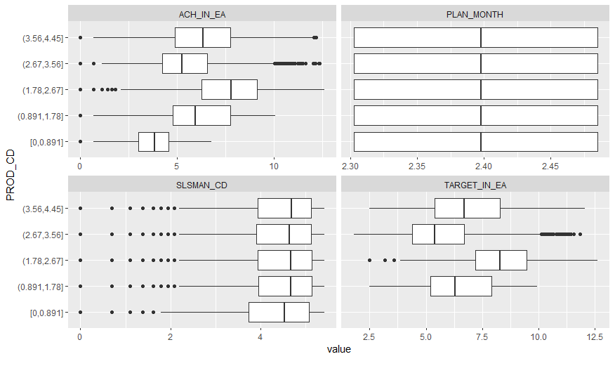
Box Plot by all variable features across transformed PROD_CD
Insights:
Achievements, targets
& salesman’s have
outliers across
products.
Plan months have no
outliers across
products.

Slide 65
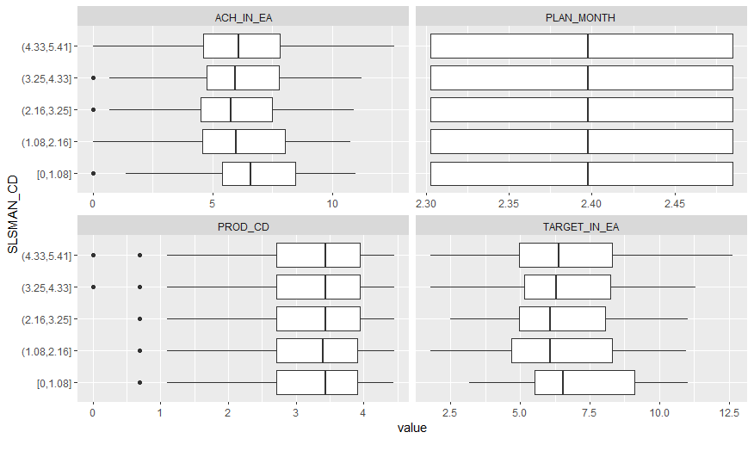
Box Plot by all variable features across transformed SLSMAN_CD
Insights:
Achievements &
products have lower
extreme outliers across
salesman’s.
Plan months & targets
have no outliers across
salesman’s.

Slide 66
Box Plot by all variable features across transformed TARGET_IN_EA
Insights:
Achievements,
products &
salesman’s
have outliers across
targets.
Plan months have no
outliers.

Slide 67
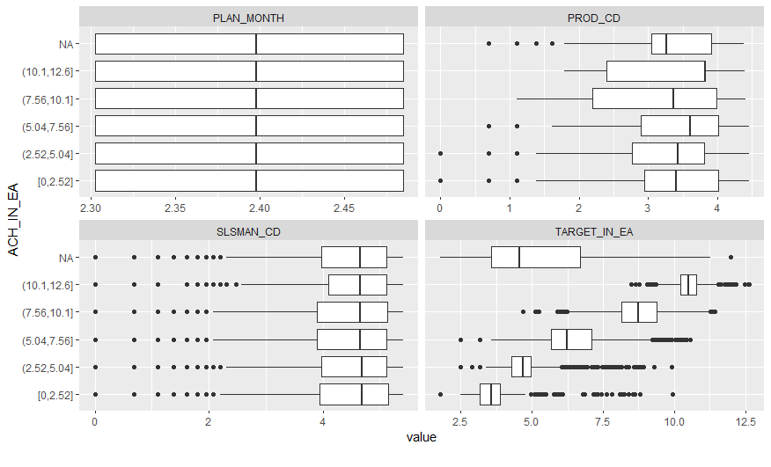
Box Plot by all variable features across transformed ACH_IN_EA
Insights:
Targets, salesman’s
& products have
outliers
across the
achievements.
Plan months have no
outliers across the
achievements.

Slide 68
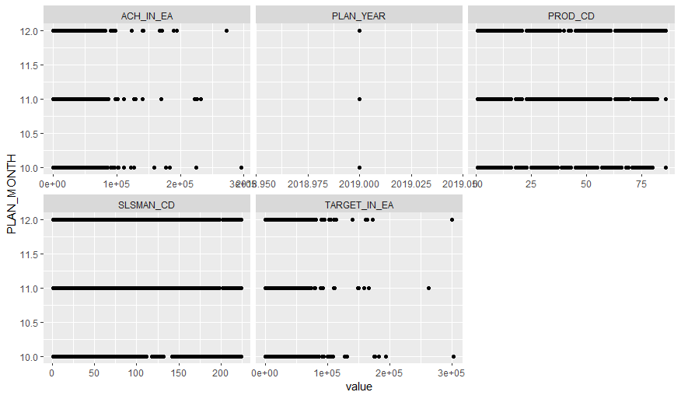
Scatter Plot by all variable features across PLAN_MONTH
Insights:
Achievements are low
in 11th month, moderate
in 12th month, highest in
10th month.
Plan months are three.
Products are distributed
across almost all three
months.
Salesman’s are allocated
in all three months for
selling products.
Targets are low in
11th month, moderate in
12th month & highest in
10th month.

Slide 69
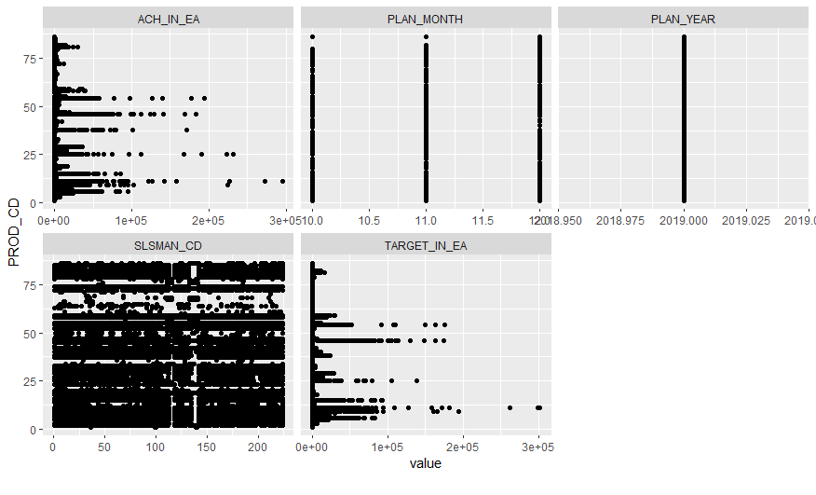
Scatter Plot by all variable features across PROD_CD
Insights:
Products range 63-80 have
lowest & 1-13 products
range have highest
achievements.
Products range 60-70
products are assigned
to only few salesman’s.
Remaining products are
assigned to all salesman’s.
1-13 products ranges
have highest targets
& 61-79 products range
have lowest targets.
Almost all products are
assigned in all three
months for selling.

Slide 70
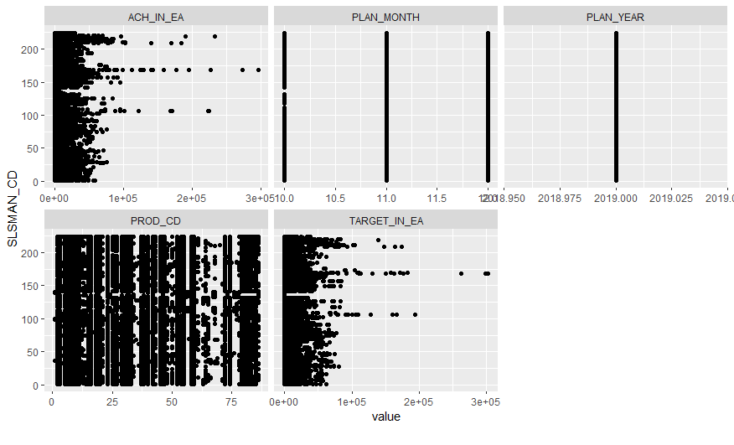
Scatter Plot by all variable features across SLSMAN_CD
Insights:
Salesman’s range 140-
162 have highest &
1-49 salesman’s have
lowest achievements.
Salesman’s range 140-
162 have highest &
1-49 salesman’s have
lower targets.
Products range 60-70
products are assigned
to only few salesman’s.

Slide 71

Scatter Plot by all variable features across TARGET_IN_EA
Insights:
1-Rs.1Lac targets
range have more
achievements.
1-Rs.3Lac targets
range have highest
achievements.
1-13 products ranges
have highest targets
& 61-79 products
range have lowest
targets.
Salesman's 147-224
range have higher
targets range1-
Rs.3Lac.

Slide 72

Scatter Plot by all variable features across ACH_IN_EA
Insights:
Achievements are low
in 11th month, moderate
in 12th month, highest in
10th month.
Products range 63-80
have lowest & 1-13
products range have
highest achievements.
Salesman's 147-224
range have higher
targets range1-Rs.3Lac.
Salesman’s range 140-
162 have highest &
1-49 salesman’s have
lowest achievements.

Slide 73
Visualization HTML report generation in webbrowser of all features
Code:
create_report(Final_Dataset)

Slide 74
Preprocessing of “Final_dataset” (Training dataset)
Removed “PLAN_YEAR” feature due to it has no correlation with all other features.
No duplicates were present in data set after checking duplicates for it.
As per EDA insights normalized feature TARGET_IN_EA & ACH_IN_EA due to they are not normalized.
Created new “final_data” after normalizing two features.

Slide 75
Preprocessing of “Validation_dataset” (Testing dataset)
Removed “PLAN_YEAR” feature due to it has no correlation with all other features.
No duplicates were present in data set after checking duplicates for it.
As per EDA insights normalized feature TARGET_IN_EA due to they are not normalized.
Created new “validation_data” after normalizing target features.

Slide 76
Trained the five models for getting achievement for January month
Multilinear Regression
Neural Network
Support vector machine (SVM)
Random Forest
XGBoost

Slide 77
Trained Multilinear Regression model
Sales_ach <- lm(ACH_IN_EA~PROD_CD+SLSMAN_CD+PLAN_MONTH+TARGET_IN_EA,
data=final_data)
summary(Sales_ach)

Slide 78
Trained Neural Network model
install.packages("neuralnet")
library(neuralnet)
sales_ach_model <- neuralnet(ACH_IN_EA~PROD_CD+SLSMAN_CD+PLAN_MONTH+TARGET_IN_EA,
data = final_data, hidden = 4, linear.output = FALSE )

Slide 79
Trained SVM model
install.packages("kernlab")
library(kernlab)
sales_ach_classifier <- ksvm(ACH_IN_EA ~ ., data = final_data, kernel = "vanilladot")

Slide 80
Trained Random Forest model
install.packages("caret", dependencies = TRUE)
install.packages("randomForest")
library(randomForest)
library(caret)
# Prepare random forest model
sales_achievement_model <- randomForest(ACH_IN_EA~.,data=final_data,ntree=500)

Slide 81
Trained XGboost model
##Set the environment
install.packages("xgboost")
library(xgboost)
# Prepare the XGboost model
sales_ach_model <- train(ACH_IN_EA~.,
data = final_data,
method= "xgbTree",
trControl= Control_parameters)

Slide 82
Predict the achievement for January month
After training the models predicted achievement for January month on “validation data” (testing dataset).
Now January month achievement added in validation data set & created new dataset
validation_data1.

Slide 83
Trained the model for predicting February month target
Multilinear Regression
Neural Network
Support vector machine (SVM)
Random Forest
Xgboost

Slide 84
Trained Multilinear Regression model
Sales_target <-lm(TARGET_IN_EA~PROD_CD+SLSMAN_CD+PLAN_MONTH+ACH_IN_EA,
data=final_data)
summary(Sales_target)

Slide 85
Trained Neural Network model
install.packages("neuralnet")
library(neuralnet)
sales_target_model <- neuralnet(TARGET_IN_EA~PROD_CD+SLSMAN_CD+PLAN_MONTH+ACH_IN_EA,
data = final_data, hidden = 4, linear.output = FALSE )

Slide 86
Trained SVM model
install.packages("kernlab")
library(kernlab)
sales_target_classifier <- ksvm(TARGET_IN_EA ~ ., data = final_data,
kernel = "vanilladot")

Slide 87
Trained Random Forest model
install.packages("caret", dependencies = TRUE)
install.packages("randomForest")
library(randomForest)
library(caret)
# Prepare random forest model
sales_target_model <- randomForest(TARGET_IN_EA~.,data=final_data,ntree=500)

Slide 88
Trained XGboost model
##Set the environment
install.packages("xgboost")
library(xgboost)
# Prepare the XGboost model
sales_target_model <- train(TARGET_IN_EA~.,
data = final_data,
method= "xgbTree",
trControl= Control_parameters1)

Slide 89
Predicting the target on validation data1
After training models we predicted February month target for validation data1(testing data).
Also predicted target on final_data(training dataset).
Now checked the training & testing accuracy of all model which details are available in next slide.

Slide 90
Training and Testing accuracy of all models
Sr. No. | Model Name | Training RMSE | R^2 or Training Accuracy | Testing RMSE | R^2 or Testing Accuracy
1 | Multilinear Regression | 0.17 | 0.8335 | 0.189 | 0.810
2 | Neural Network | 0.016 | 0.9838 | 0.0451 | 0.9554
3 | Support vector machine | 0.0166 | 0.9833 | 0.007 | 0.9928
4 | Random Forest | 0.0145 | 0.9854 | 0.0337 | 0.9662
5 | XGBoost | 0.0095 | 0.9904 | 0.0273 | 0.9726

Slide 91
Selected model for deployment
We selected XGBoost model for deployment in RShiny.

Slide 92
THANK YOU

